Slide 1

MEDTRONIX
Date : 5/9/2022
Team : 3
Camp : C0317

Slide 2
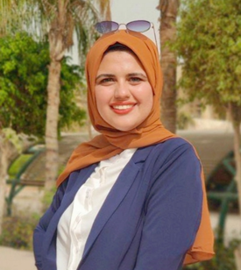
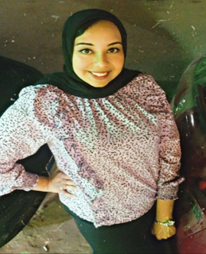
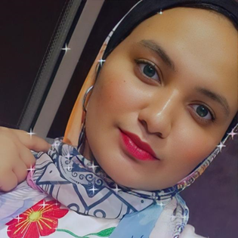
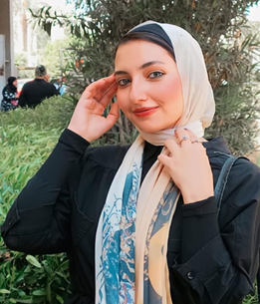
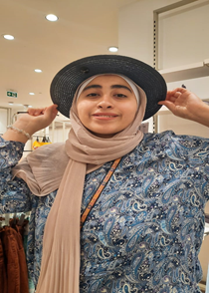
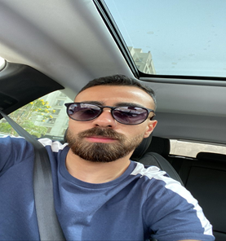
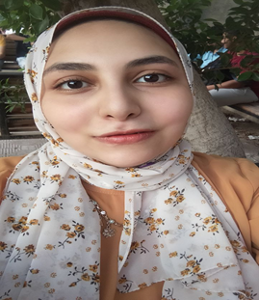
Founder
NOURAN MOHMED EL-MASRY
nouranelmasry18@gmail.com
ESRAA HANY TALAAT
eh614230@gmail.com
Fatma el-zahraa adham
fatmaadham197@gmail.com
SALMA ESSAM
essamsalma858@gmail.com
AYA MOHMED SHERBY
ayam58282@gmail.com
ISLAM SAMIR MOHAMED
Islamsamir615@gmail.com
SONDOS EMARA
sondos.basha2002@gmail.com

Slide 3
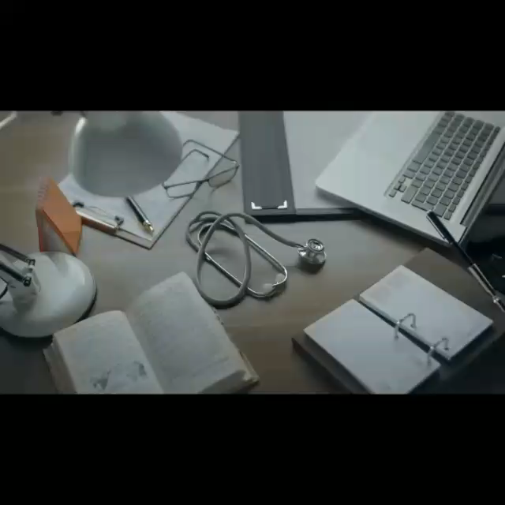
inspiration

Slide 4
The problem
- Problem Area:
A segment of children and teenagers in range between 8-20 years where they're living in Aswan governorate.
- Problem to solve:
1.Many deaths in children are due to heart damage.
2.Children feel different just because they don't have heart disease.
3.Children being capable of doing activities as others do.
4.About one in every 100 children has a heart problem.
5.Irregular Heartbeat in heart disease.

Slide 5
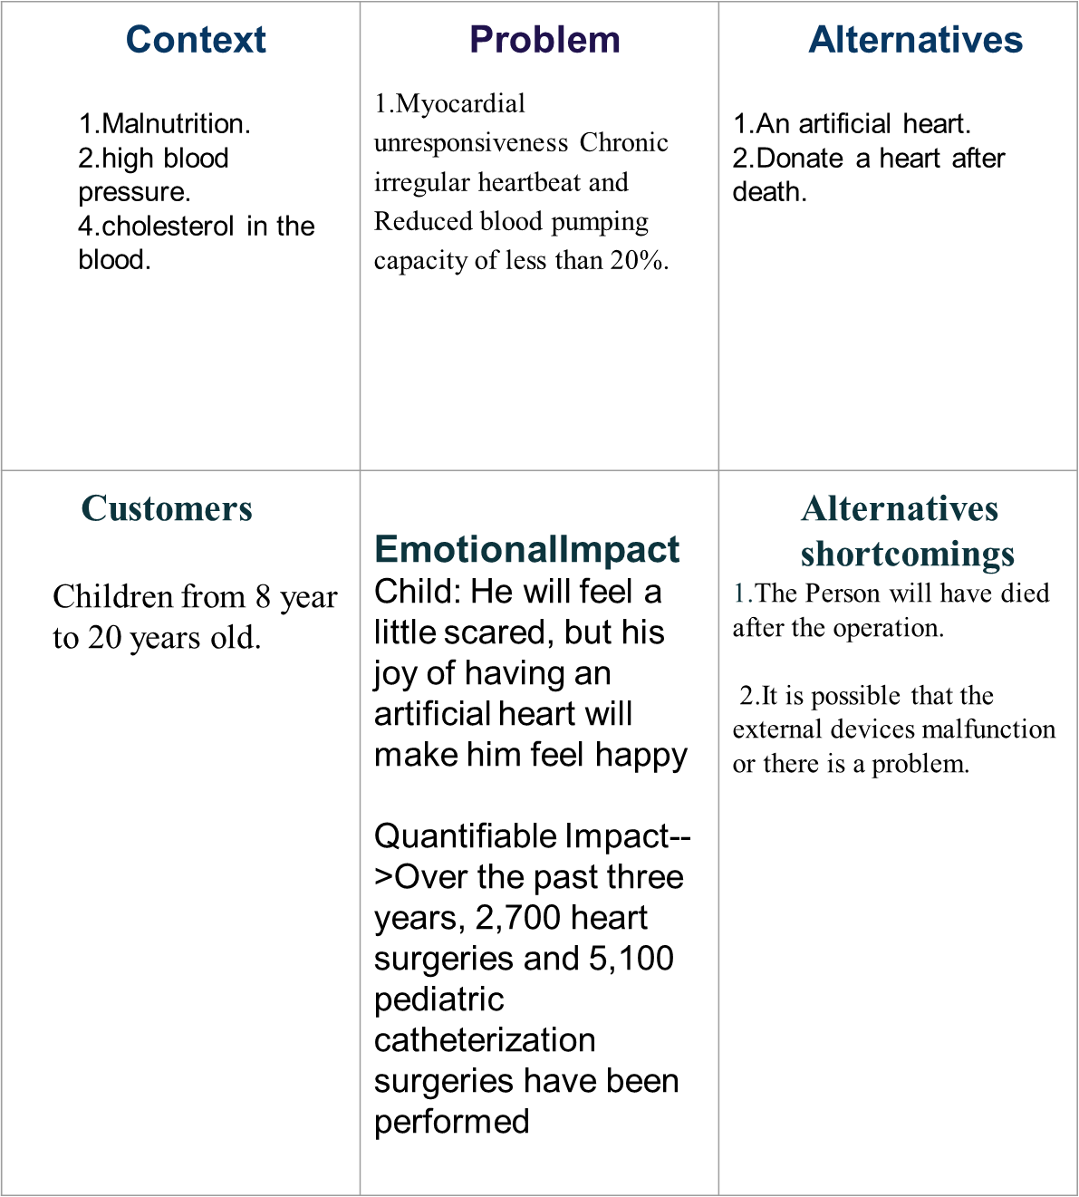
Problem Statement Canvas

Slide 6

Personas#1
Key attributes:
- Quick adaptation to user’s needs
- fast loading time and high performance
Short description: Ahmed yasser , 32, is a busy developer who works on multiple projects. He has a lot on his plate and would prefer to
provide recognition in the moment and then move on to
the next thing.
Needs: Make the intranet customized to user type features that can streamline or support existing systems. and easy to use,Add
Challenges: Determining what is important to the use and Finding Creative solution for the problem.
Opportunities: Self-development, feeling for others, helping them, spreading a culture of love, cooperation, and donating to save the lives of sick people, create programs that help people and facilitate their lives

Slide 7

Persona#2
Key attributes: He is 11 years old, weak and short boy .
Short description: Muhannad is a boy lives in Aswan He has swelling in the legs and around the eyes, , the colorof the skin has changed in some areas of the body , He suffers from heart disease.
Needs: He suffers from heart disease and needs a heart transplant,
but he is on the waiting list until there is a suitable donor.
Challenges: The inability to make effort or play, and it is possible to wait for a long time to find a donor and may suffer from health complications
Opportunities: People who are on the waiting list to find a suitable heart can be implanted with an artificial heart to save them for as long as possible until a suitable heart is available and the operation is performed for the patient

Slide 8
Empathy Field Work
- For treatment Children from 8 year to 20 years old.
- For Donation Adults from 25 year to 40.
- For Helping by Money Institutions and organizations concerned with heart health
-The activities that we make to understand the needs
- A survey was made, and we uploaded it to social media. We asked some
- relatives and friends and collected people's opinions about the problem we
- are trying to solve and told them the solutions we want to solve the problem
with.

Slide 9
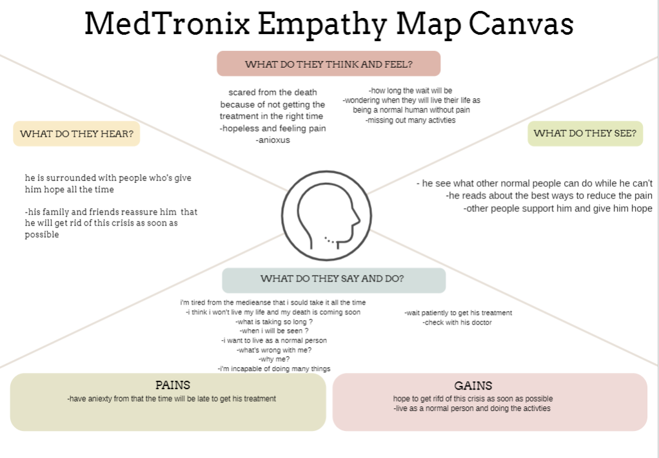
Empathy Map

Slide 10
Problem Definition
POV Model
User: a segment of children and teenagers in rang between 8-20 years where they're living in Aswan governorate.
Need: undergo a heart transplant surgery.
Insights: they want to live their life as normal people and being capable of doing activities as others do.

Slide 11
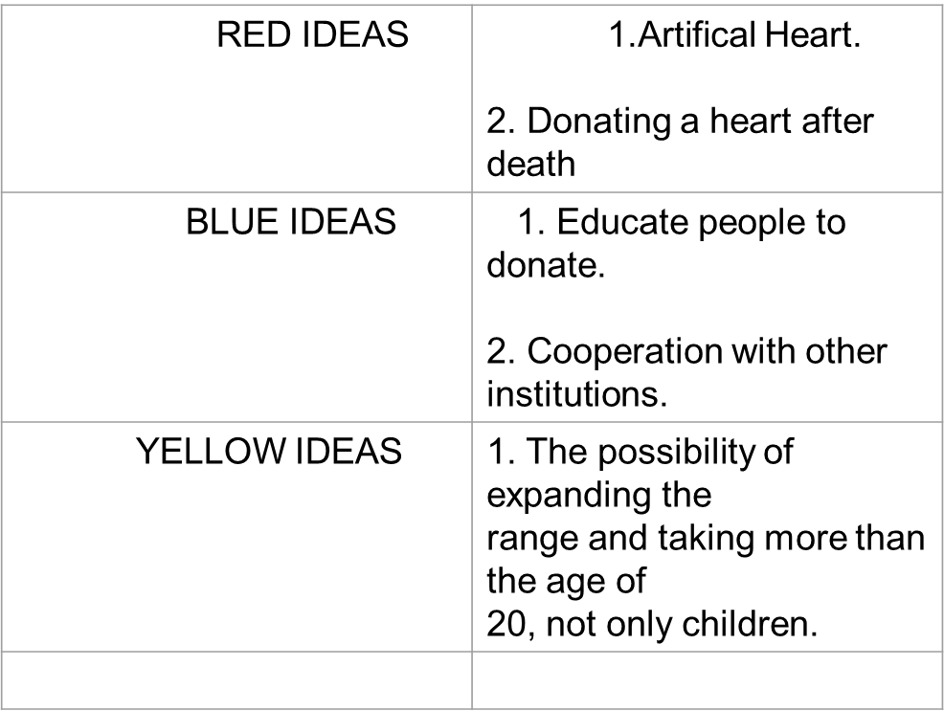
How Might We…..?

Slide 12
Selected Idea
1.Artifical Heart and Donating a heart after death.
how does it work?
An artificial heart is a device designed to do the work of a normal heart. It is like heart, Normally, it has two ventricles that pump blood around the body. One of the ventricles One pumps blood to the lungs, while the other pumps blood to the rest of the body. and design, The artificial heart,so that it fits into the space that is vacant after the sick heart is removed from the human chest.
Core functionality of idea:
Reducing waiting for children with heart disease by making an artificial heart using high technology, temporary until there is adonor.

Slide 13
Technology Description
Tech components of the product:
We will use AI to make the artificial heart.
Technical block diagram for solution:
We will use web development for the platform in order to categorize people and direct them to donate and collect information about the injured

Slide 14
Prototype
Discuss Prototype:
It is possible to log in from three people who are the donor, the patient and the supporter. The patient and the donor provide the required analyzes every period of time and there is a chat bot to follow up on the health status of the donor.
Framework design:
Using adobe xd Framework to make a ux prototype.
Link→ view prototype

Slide 15
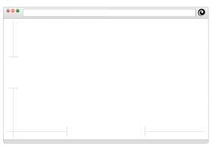
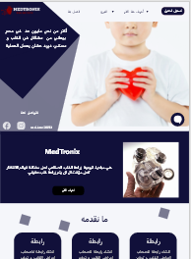
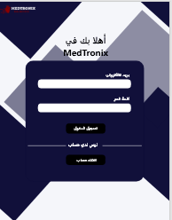
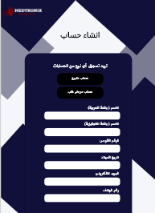
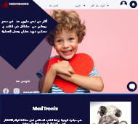

Slide 16
Value Proposition
Unique value proposition:
- The project can help many children to save their lives
- lead a normal life.
- Children playing sports.
- Not feeling different just because they're heart patients

Slide 17
competitors
Alternative solutions to the problem?
Protecting the hearts of children from the age of 15:5 years from rheumatism of the heart. meditations are good for complete novices and seasoned practitioners, and you have your pick when it comes to how long you can dedicate to the app each day.app will offers a mood check-in feature that tracks your mood throughout the day and puts together a personalized report of your moods.
Competitors:
There are many medical websites that publish and give medical advice for heart patients, such as the Webteb and the Al-Tibbi website.
Why think that we are better?
We provide services with the latest technology

Slide 18

Cost Structure/Financial Projections
What are the most important costs inherent in our business model?
As for the finances, there must be an investor to support the project in its infancy and donors from people to establish heart transplants and artificial heart manufacturing, in addition to advertisements on the platform.
Which Key Resources are most expensive?
social Platform.
Which Key Activities are most expensive?
Maintenance and developed our platform.

Slide 19
Revenue Streams
For customers :
Free for patient.
business earns money:
Every click to the website.
Revenue from campaigns.
Marketing.

Slide 20
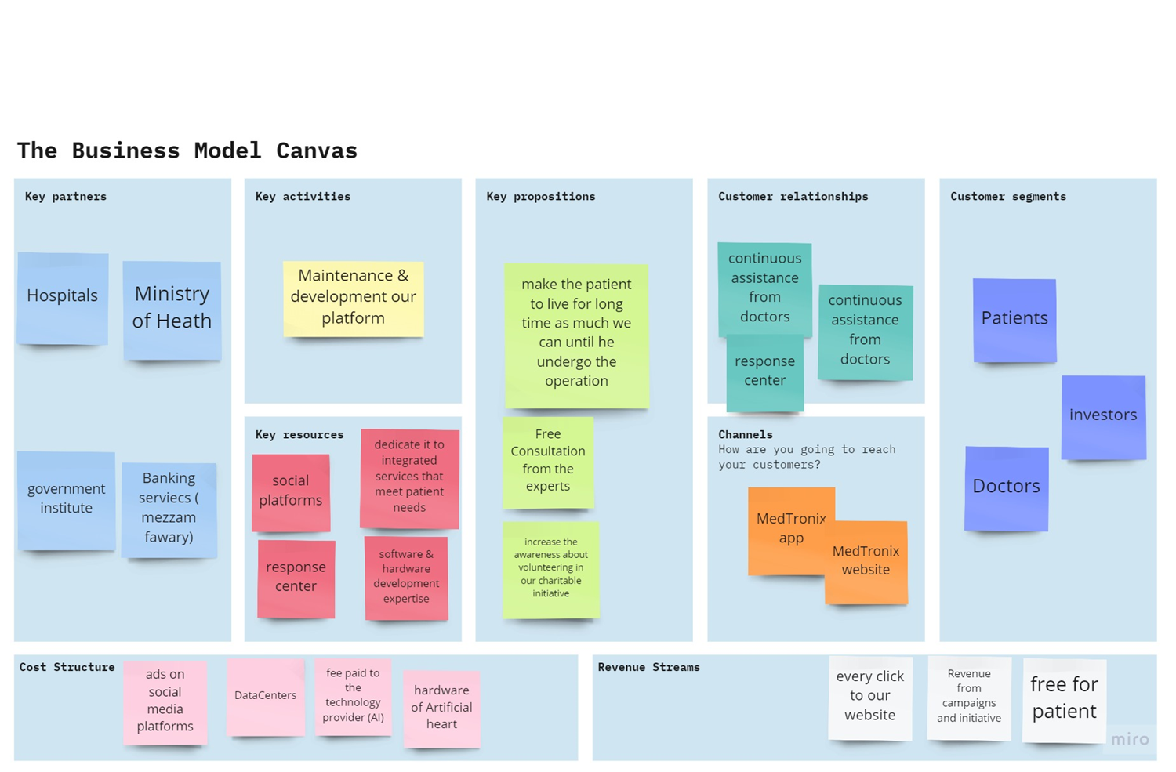

Slide 21
Pitching Closing Statement
MY COMPANY :
- MED-TRONIX.
IS DEVELOPING:
- Artificial heart.
TO HELP:
a segment of children and teenagers in range between 8-20 years where they're living in aswan governorate, Because children do not feel that they are different just because they are heart patients and are unable to play like other children..

